Slide 1

Use Cases
Homework : Reading from page 88 to 109
Why we create sequence diagram from use case diagram?

Slide 2
Topics
Actors, Goals
Sketchy/Summary Use Cases
Use Case Diagram
Traceability Matrix
System Boundary and Subsystems
Detailed Use Case Specification
System Sequence Diagrams
Security and Risk Management

Slide 3
Use Cases
Used for Functional Requirements Analysis and Specification
A use case is a step-by-step description of how a user will use the system-to-be to accomplish business goals
Three key elements of use cases:
  Environmental agents or actors that will cooperate with the system
  Use case diagram shows relations of the actors and use cases
  Use case scenarios are plans for realization of user goals
  or handling contingencies
Use cases scenarios or scripts show an envisioned sequence of cooperative interactions between the external actors and the system-to-be

Slide 4
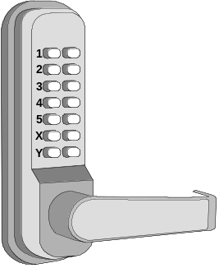
Deriving Use Cases from
System Requirements
REQ1: Keep door locked and auto-lock
REQ2: Lock when “LOCK” pressed
REQ3: Unlock when valid key provided
REQ4: Allow mistakes but prevent dictionary attacks
REQ5: Maintain a history log
REQ6: Adding/removing users at runtime
REQ7: Configuring the device activation preferences
REQ8: Inspecting the access history
REQ9: Filing inquiries
Initiator | Initiator’s Goal | Participants | Use Case Name
Tenant | Unlock and enter home. | Lock, Household Devices, Database | Unlock (UC‑1)
Tenant | Lock the door. | Lock, Household Devices, Database | Lock (UC‑2)
Landlord | Create a new user account and allow access to home. | Tenant, Database | AddUser (UC‑3)
Landlord | Retire an existing user account and disable access. | Database | RetireUser (UC‑4)
Tenant | Review the history of home accesses. | Database | ViewHistory (UC‑5)
Tenant | Configure the operational preferences for household devices. | Database | SetDevicePrefs (UC‑6)
Visitor | Visit a resident’s home. | Lock, Database | VisitHome (UC‑7)
Initiating actors (“users”) are already identified in user stories
Participating actors identified as part of use case analysis

Slide 5
Types of Actors
Initiating actor (also called primary actor or simply “user”): initiates the use case to achieve a goal
Participating actor (also called secondary actor): participates in the use case but does not initiate it. Subtypes of participating actors:
  Supporting actor: helps the system-to-be to complete the use case
  Offstage actor: passively participates in the use case, i.e., neither initiates nor helps complete the use case, but may be notified about some aspect of it (e.g., for keeping records)

Slide 6
Use Case
“A use case specifies the behavior of a system or a part of a system, and is a description of a set of sequences of actions, including variants, that a system performs to yield an observable result of value to an actor.”
- The UML User Guide, [Booch,99]
“An actor is an idealization of an external person, process, or thing interacting with a system, subsystem, or class. An actor characterizes the interactions that outside users may have with the system.”
- The UML Reference Manual, [Rumbaugh,99]

Slide 7
Use Case (Cont’d)
Register for Courses
A use case is rendered as an ellipse in a use case diagram. A use case is always labeled with its name.

Slide 8
Use Case (Cont’d)
An actor is rendered as a stick figure in a use case diagram. Each actor participates in one or more use cases.
Student

Slide 9
Use Case (Cont’d)
Actors may be connected to use cases
only by associations.
Register for Courses
Student

Slide 10
Use Case (Cont’d)
Here we have a Student interacting with the Registrar and the
Billing System via a “Register for Courses” use case.
Billing System
Student
Register for Courses
Registrar

Slide 11
The <<extends>> Relationship
<<extends>> relationships represent exceptional or seldom invoked cases.
The exceptional event flows are factored out of the main event flow for clarity.
Use cases representing exceptional flows can extend more than one use case.
The direction of a <<extends>> relationship is to the extended use case
Passenger
PurchaseTicket
<<extends>>
<<extends>>
<<extends>>
OutOfOrder
<<extends>>
TimeOut
Cancel
NoChange

Slide 12
The <<includes>> Relationship
<<includes>> relationship represents behavior that is factored out of the use case.
<<includes>> behavior is factored out for reuse, not because it is an exception.
The direction of a <<includes>> relationship is to the using use case (unlike <<extends>> relationships).
Passenger
PurchaseMultiCard
PurchaseSingleTicket
<<includes>>
<<includes>>
<<extends>>
CollectMoney
<<extends>>
NoChange
Cancel

Slide 13
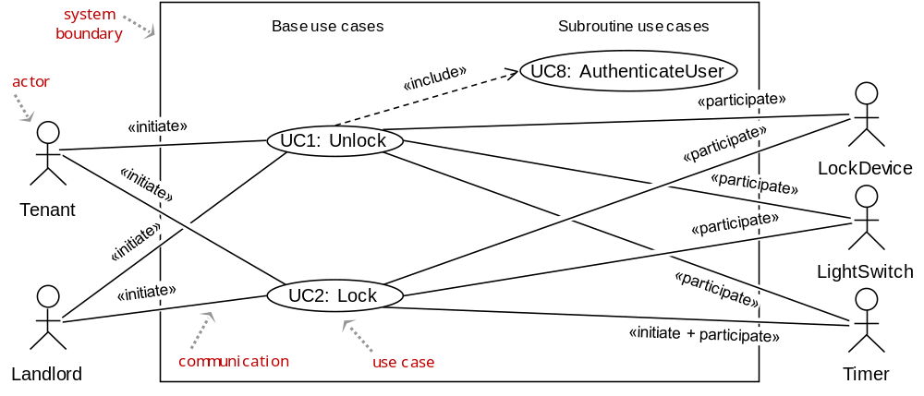
Use Case Diagram
High-level goal: ARRIVE
UC1: Unlock
UC2: Lock
UC3: AddUser
UC4: RemoveUser
UC5: InspectAccessHistory
UC6: SetDevicePrefs
UC7: AuthenticateUser
UC8: Login
Interestingly, we keep mentioning “home” and “doors,” but they do not appear as actors!
This issue will be discussed in a later lecture (Domain Model)

Slide 14
DRY Use Cases
Remove Redundancies Using Subroutine Use Cases
Don't repeat yourself
  https://en.wikipedia.org/wiki/Don%27t_repeat_yourself
In Detailed Use cases or System Sequence Diagrams (described later):
Remove redundant parts of base use cases that are common to multiple use cases by parametrizing them as subroutine use cases
UC5: InspectAccessHistory
«extend»
ManageAccount
«extend»
UC6: SetDevicePrefs

Slide 15
Subroutine Use Cases
Optional Use Cases: «extend»
UC1: Unlock
UC2: Lock
UC3: AddUser
UC4: RemoveUser
UC5: InspectAccessHistory
UC6: SetDevicePrefs
UC7: AuthenticateUser
UC8: Login
Example optional subroutine use cases:
UC5: InspectAccessHistory
«extend»
ManageAccount
«extend»
UC6: SetDevicePrefs
Key differences between «include» and «extend» relationships
Included use case
Extending use case
Is this subroutine use case optional?
No
Yes
Is the base use case
complete without this use case?
No
Yes
Is the execution of subroutine use case conditional?
No
Yes
Does this subroutine use case change the behavior of the base use case?
No
Yes
[ Source: Robert Maksimchuk & Eric Naiburg: UML for Mere Mortals, Addison-Wesley, 2005. ]

Slide 16
Login Use Case?
BAD:
GOOD:
Login
AddUser
AddUser
«include»
Login
Landlord
SetDevicePrefs
Landlord
SetDevicePrefs
«include»

Slide 17
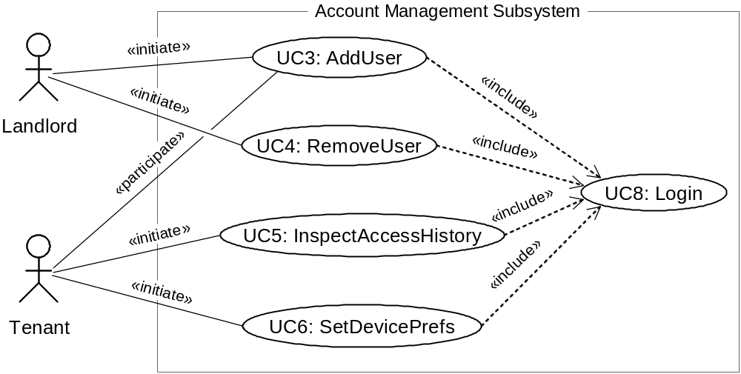
Use Case Diagram: Account Management
UC1: Unlock
UC2: Lock
UC3: AddUser
UC4: RemoveUser
UC5: InspectAccessHistory
UC6: SetDevicePrefs
UC7: AuthenticateUser
UC8: Login

Slide 18
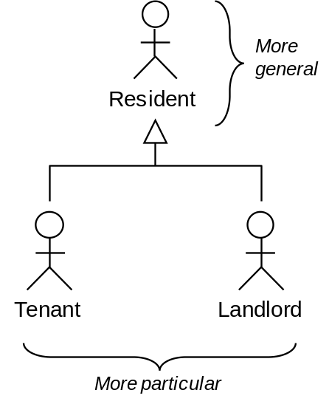
Use Case Generalizations
UC1: Unlock
UC2: Lock
UC3: AddUser
UC4: RemoveUser
UC5: InspectAccessHistory
UC6: SetDevicePrefs
UC7: AuthenticateUser
UC8: Login
More abstract representations can be derived from particular representations
UC9: ManageUsers
UC3: AddUser
UC4: RemoveUser
Actor Generalization
Use Case Generalization

Slide 19
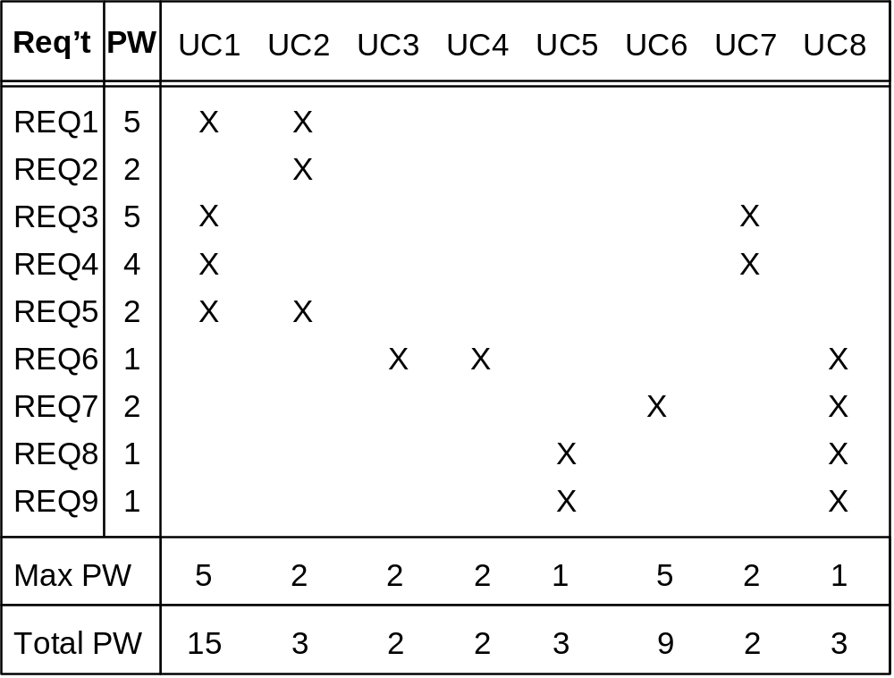
Traceability Matrix (1)
Mapping: System requirements to Use cases
UC1: Unlock
UC2: Lock
UC3: AddUser
UC4: RemoveUser
UC5: InspectAccessHistory
UC6: SetDevicePrefs
UC7: AuthenticateUser
UC8: Login
REQ1: Keep door locked and auto-lock
REQ2: Lock when “LOCK” pressed
REQ3: Unlock when valid key provided
REQ4: Allow mistakes but prevent dictionary attacks
REQ5: Maintain a history log
REQ6: Adding/removing users at runtime
REQ7: Configuring the device activation preferences
REQ8: Inspecting the access history
REQ9: Filing inquiries
Continued for domain model, design diagrams, …

Slide 20
Traceability Matrix Purpose
To check that all requirements are covered by the use cases
To check that none of the use cases is introduced without a reason (i.e., created not in response to any requirement)
To prioritize the work on use cases

Slide 21
Schema for Detailed Use Cases
Use Case UC-#: |  |  |  | Name / Identifier [verb phrase]
Related Requirements: |  |  |  | List of the requirements that are addressed by this use case
Initiating Actor: |  |  |  | Actor who initiates interaction with the system to accomplish a goal
Actor’s Goal: |  |  |  | Informal description of the initiating actor’s goal
Participating Actors: |  |  |  | Actors that will help achieve the goal or need to know about the outcome
Preconditions: |  |  |  | What is assumed about the state of the system before the interaction starts
Postconditions: |  |  |  | What are the results after the goal is achieved or abandoned; i.e., what must be true about the system at the time the execution of this use case is completed
Flow of Events for Main Success Scenario:
→ | 1. | The initiating actor delivers an action or stimulus to the system (the arrow indicates the direction of interaction, to- or from the system)
← | 2. | The system’s reaction or response to the stimulus; the system can also send a message to a participating actor, if any
→ | 3. | …
Flow of Events for Extensions (Alternate Scenarios): What could go wrong? List the exceptions to the routine and describe how they are handled
→ | 1a. | For example, actor enters invalid data
← | 2a. | For example, power outage, network failure, or requested data unavailable
 |  | …
The arrows on the left indicate the direction of interaction: → Actor’s action; ← System’s reaction

Slide 22
Use Case 1: Unlock
Use Case UC-1: |  |  | Unlock
Related Requirem’ts: |  |  | REQ1, REQ3, REQ4, and REQ5 stated in Table 2-1
Initiating Actor: |  |  | Any of: Tenant, Landlord
Actor’s Goal: |  |  | To disarm the lock and enter, and get space lighted up automatically.
Participating Actors: |  |  | LockDevice, LightSwitch, Timer
Preconditions: |  |  | • The set of valid keys stored in the system database is non-empty. • The system displays the menu of available functions; at the door keypad the menu choices are “Lock” and “Unlock.”
Postconditions: |  |  | The auto-lock timer has started countdown from autoLockInterval.
Flow of Events for Main Success Scenario:
→ | 1. | Tenant/Landlord arrives at the door and selects the menu item “Unlock”
 | 2. | include::AuthenticateUser (UC-7)
← | 3. | System (a) signals to the Tenant/Landlord the lock status, e.g., “disarmed,” (b) signals to LockDevice to disarm the lock, and (c) signals to LightSwitch to turn the light on
← | 4. | System signals to the Timer to start the auto-lock timer countdown
→ | 5. | Tenant/Landlord opens the door, enters the home [and shuts the door and locks]

Slide 23
Subroutine «include» Use Case
Use Case UC-7: |  |  |  | AuthenticateUser (sub-use case)
Related Requirements: |  |  |  | REQ3, REQ4 stated in Table 2‑1
Initiating Actor: |  |  |  | Any of: Tenant, Landlord
Actor’s Goal: |  |  |  | To be positively identified by the system (at the door interface).
Participating Actors: |  |  |  | AlarmBell, Police
Preconditions: |  |  |  | • The set of valid keys stored in the system database is non-empty. • The counter of authentication attempts equals zero.
Postconditions: |  |  |  | None worth mentioning.
Flow of Events for Main Success Scenario:
← | 1. | System prompts the actor for identification, e.g., alphanumeric key
→ | 2. | Tenant/Landlord supplies a valid identification key
← | 3. | System (a) verifies that the key is valid, and (b) signals to the actor the key validity
Flow of Events for Extensions (Alternate Scenarios):
2a. Tenant/Landlord enters an invalid identification key
← | 1. | System (a) detects error, (b) marks a failed attempt, and (c) signals to the actor
← |  | 1a. | System (a) detects that the count of failed attempts exceeds the maximum allowed number, (b) signals to sound AlarmBell, and (c) notifies the Police actor of a possible break-in
→ | 2. | Tenant/Landlord supplies a valid identification key
 | 3. | Same as in Step 3 above

Slide 24
Acceptance Test Case for
UC-7 Authenticate User
Test-case Identifier: | TC-1
Use Case Tested: | UC-1, main success scenario, and UC-7
Pass/fail Criteria: | The test passes if the user enters a key that is contained in the database, with less than a maximum allowed number of unsuccessful attempts
Input Data: | Numeric keycode, door identifier
Test Procedure: |  | Expected Result:
Step 1. Type in an incorrect keycode and a valid door identifier |  | System beeps to indicate failure; records unsuccessful attempt in the database; prompts the user to try again
Step 2. Type in the correct keycode and door identifier |  | System flashes a green light to indicate success; records successful access in the database; disarms the lock device

Slide 25
Use Case 2: Lock
Use Case UC-2: |  |  | Lock
Related Requirements: |  |  | REQ1, REQ2, and REQ5 stated in Table 2-1
Initiating Actor: |  |  | Any of: Tenant, Landlord, or Timer
Actor’s Goal: |  |  | To lock the door & get the lights shut automatically (?)
Participating Actors: |  |  | LockDevice, LightSwitch, Timer
Preconditions: |  |  | The system always displays the menu of available functions.
Postconditions: |  |  | The door is closed and lock armed & the auto-lock timer is reset.
Flow of Events for Main Success Scenario:
→ | 1. | Tenant/Landlord selects the menu item “Lock”
← | 2. | System (a) signals affirmation, e.g., “lock armed,” (b) signals to LockDevice to arm the lock (if not already armed), (c) signal to Timer to reset the auto-lock counter, and (d) signals to LightSwitch to turn the light off (?)
Flow of Events for Extensions (Alternate Scenarios):
2a. System senses that the door is not closed, so the lock cannot be armed
← | 1. | System (a) signals a warning that the door is open, and (b) signal to Timer to start the alarm counter
→ | 2. | Tenant/Landlord closes the door
← | 3. | System (a) senses the closure, (b) signals affirmation to the Tenant/Landlord, (c) signals to LockDevice to arm the lock, (d) signal to Timer to reset the auto-lock counter, and (e) signal to Timer to reset the alarm counter

Slide 26
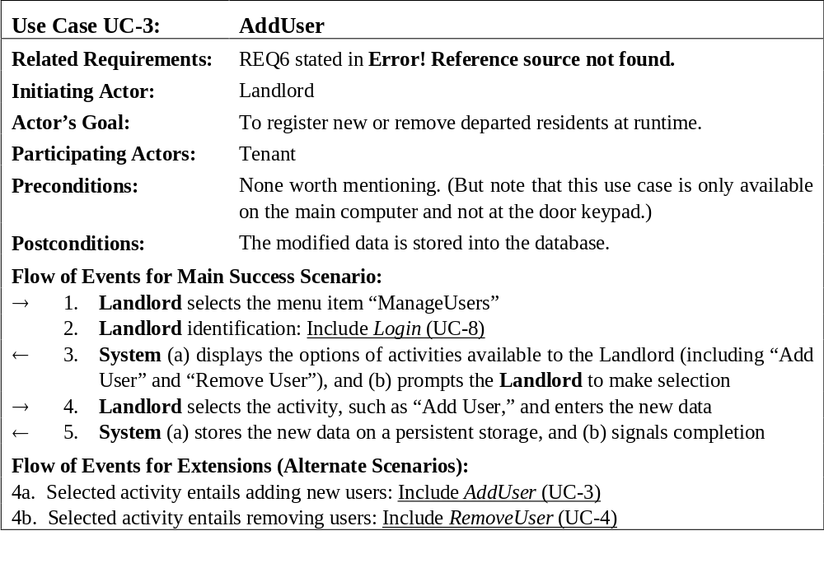
Use Case 3: Add User

Slide 27
Use Case 5: Inspect Access History
Use Case UC-5: |  |  | Inspect Access History
Related Requirements: |  |  | REQ8 and REQ9 stated in Table 2-1
Initiating Actor: |  |  | Any of: Tenant, Landlord
Actor’s Goal: |  |  | To examine the access history for a particular door.
Participating Actors: |  |  | Database, Landlord
Preconditions: |  |  | Tenant/Landlord is logged in the system and is shown a hyperlink “View Access History.”
Postconditions: |  |  | None.
Flow of Events for Main Success Scenario:
→ | 1. | Tenant/Landlord clicks the hyperlink “View Access History”
← | 2. | System prompts for the search criteria (e.g., time frame, door location, actor role, event type, etc.) or “Show all”
→ | 3. | Tenant/Landlord specifies the search criteria and submits
← | 4. | System prepares a database query that best matches the actor’s search criteria and retrieves the records from the Database
→ | 5. | Database returns the matching records
← | 6. | System (a) additionally filters the retrieved records to match the actor’s search criteria; (b) renders the remaining records for display; and (c) shows the result for Tenant/Landlord’s consideration
→ | 7. | Tenant/Landlord browses, selects “interesting” records (if any), and requests further investigation (with an accompanying complaint description)
← | 8. | System (a) displays only the selected records and confirms the request; (b) archives the request in the Database and assigns it a tracking number; (c) notifies Landlord about the request; and (d) informs Tenant/Landlord about the tracking number

Slide 28

Example Use case: Wash Hands
How a beginner writes the use case:

Slide 29
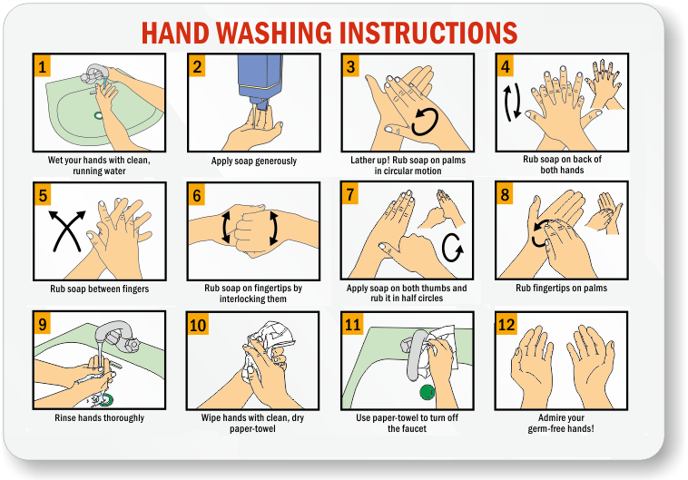
Example Use case: Wash Hands
How an experienced developer writes the use case:
But, that’s obvious! ...right?

Slide 30
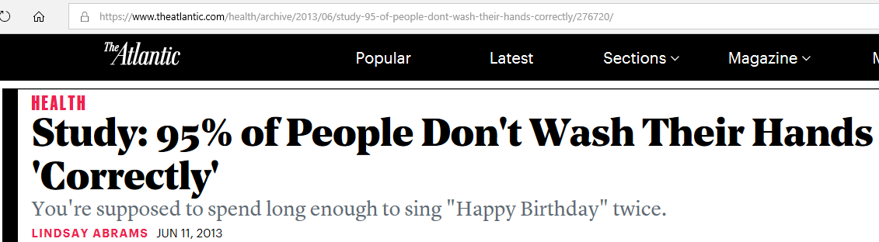
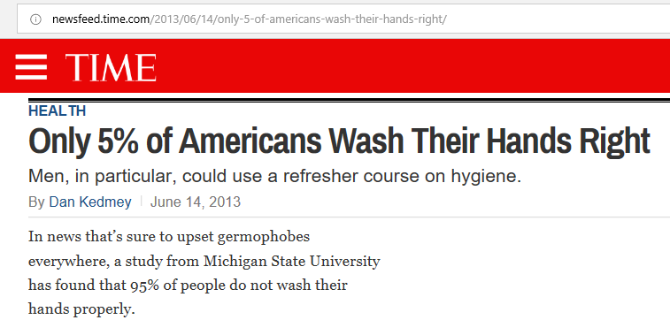
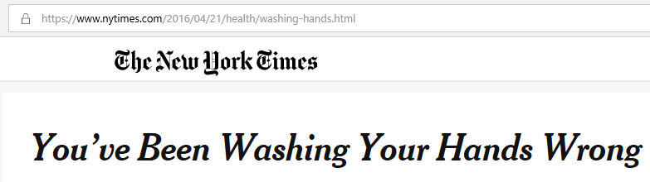
Example Use case: Wash Hands
Well, maybe not!
Notes:
http://newsfeed.time.com/2013/06/14/only-5-of-americans-wash-their-hands-right/
https://www.theatlantic.com/health/archive/2013/06/study-95-of-people-dont-wash-their-hands-correctly/276720/
https://www.nytimes.com/2016/04/21/health/washing-hands.html

Slide 31
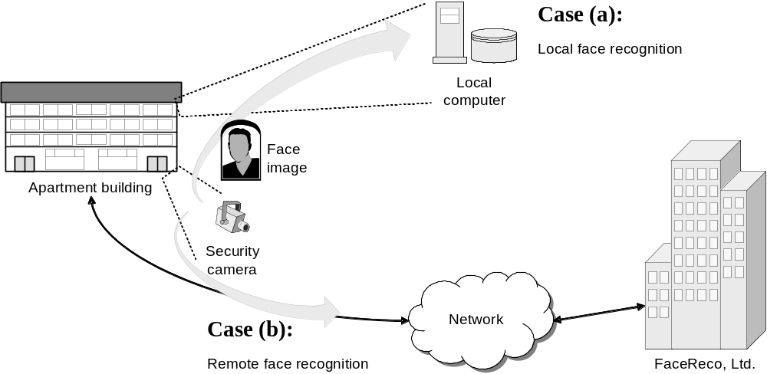
System Boundary & Subsystems
Use Case Variations Example:

Slide 32
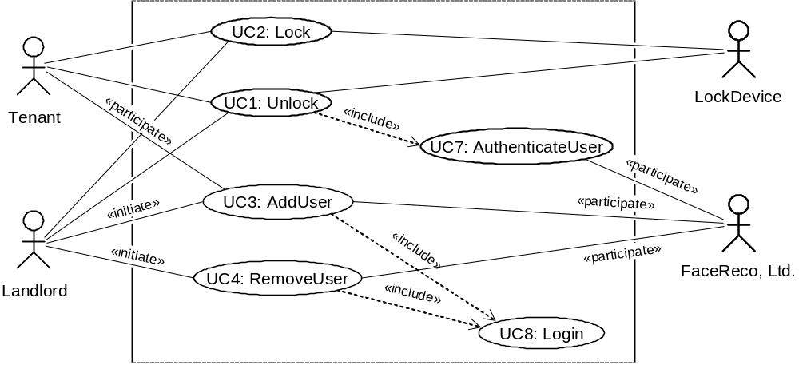
Modified Use Case Diagram
UC1: Unlock
UC2: Lock
UC3: AddUser
UC4: RemoveUser
UC5: InspectAccessHistory
UC6: SetDevicePrefs
UC7: AuthenticateUser
UC8: Login
Authentication subsystem (FaceReco, Ltd.)
is externalized from the system-to-be:

Slide 33
Security and Risk Management
Identifying and preempting the serious risks to system’s safe and successful functioning
Risk types:
  Intolerable
  As low as reasonably practical (ALARP)
  Acceptable
Example abuse case input sequence:
    invalid-key, invalid-key, … ≤ maxNumOfAttempts ;
    wait maxAttemptPeriod ; invalid-key, invalid-key, …

Slide 34
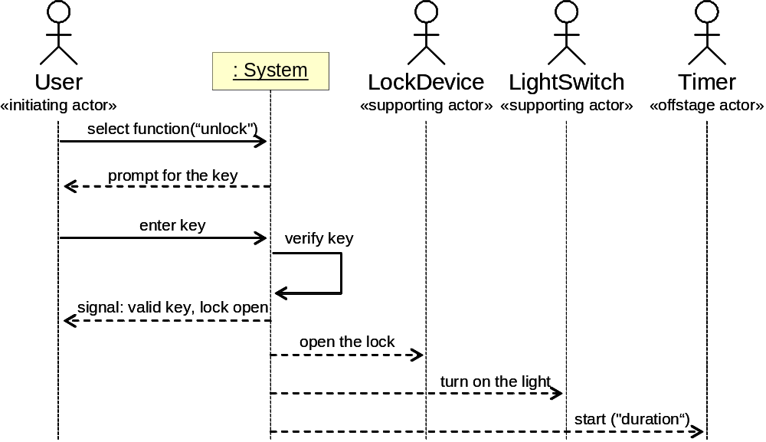
System Sequence Diagram
[Modeling System Workflows]
Use case: Unlock
Main success scenario
Similar to UML sequence diagrams,
but for actor interactions instead of software object interactions

Slide 35
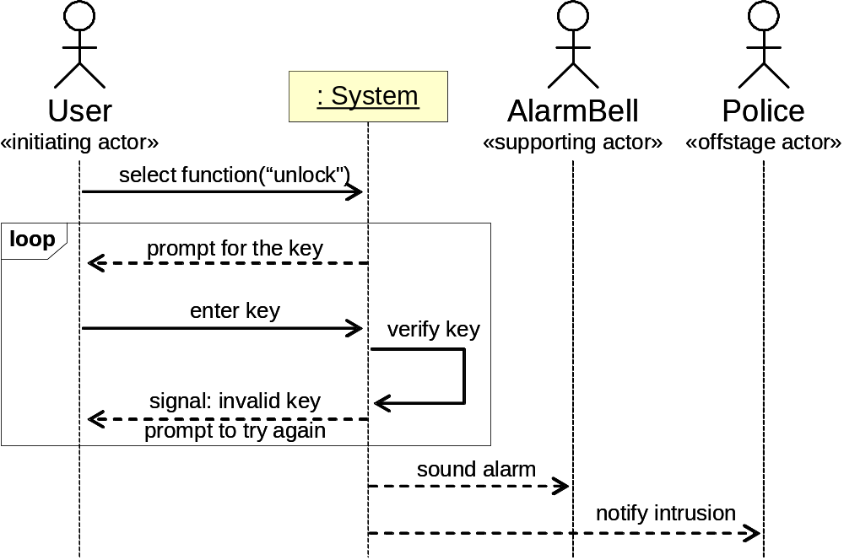
System Sequence Diagram
[Modeling System Workflows]
Use case: Unlock
Alternate scenario (burglary attempt)

Slide 36
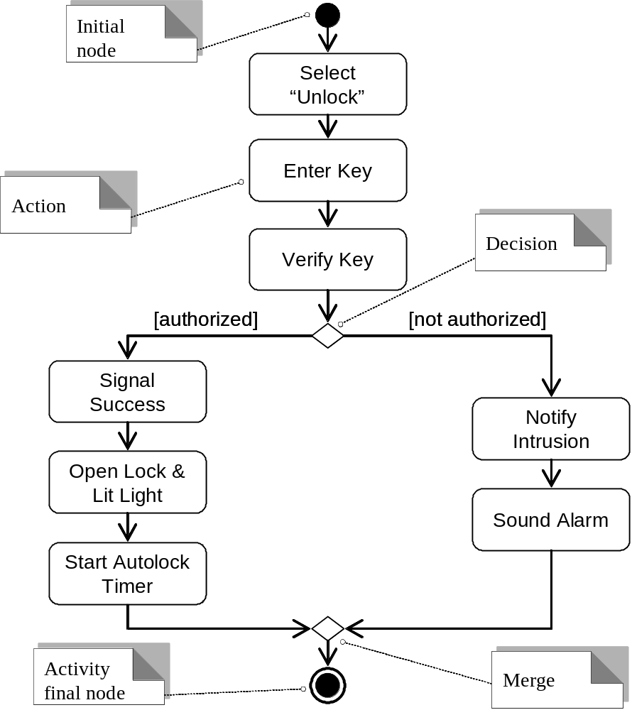
Activity Diagram
[Modeling System Workflows]

Slide 37
Limitations of Use Cases
NOTE: User stories suffer the same limitations
Often the user is using the system on behalf of the actual beneficiary. A store, agency, or bank clerk, lawyer, doctor, ... interacting with the system when providing service to a customer
Whose business goals should we consider for these use cases: direct user’s or actual beneficiary’s?
  Arguably there are merits in considering both, because otherwise we get only a partial picture.
    E.g., in the restaurant example, we discuss what the wait staff may want to do, but we often mention the guest: the guest may order this or require that.
The key importance of the end beneficiary is highlighted by the fact that automation systems often replace the intermediary in a business scenario and allow the end beneficiary to directly interact with the system.
  When the intermediary cannot be completely replaced by automation, the intermediary becomes another user (supporting actor?) instead of being interposed between the system and the actual beneficiary.

Slide 38
User Interface Requirements
Do not waste your time and your customer’s time by creating elaborate screen shots with many embellishments, coloring, shading, etc., that only distract attention from most important aspects of the interface
Hand-drawing the proposed interface forces you to economize and focus on the most important features
Only when there is a consensus that a good design is reached, invest effort to prototype the interface
https://arstechnica.com/gadgets/2018/01/with-ink-to-code-microsoft-is-turning-back-of-napkin-sketches-into-software/

Slide 39
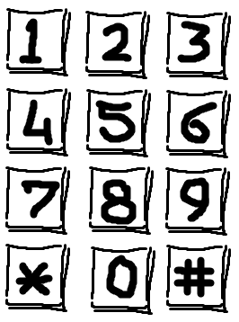
Example: Safe Home Access
User interface requirement:
The UI must be simple for occasional visitors who will not have time to familiarize or to study user’s documentation.
Initial design of the door keypad:
Analysis:
If “Unlock” button is not available, then the system could simply take the first N digits and validate as the key.
If “Unlock” button is available, then the system could take the last N digits and validate as the key (and ignore any number >N of previously entered digits).
The advantage of the latter approach is that it allows correcting for unintentional mistakes during typing, so the legitimate user can have more opportunities to attempt.
Note that this feature will not help the burglar trying a dictionary attack.

Slide 40
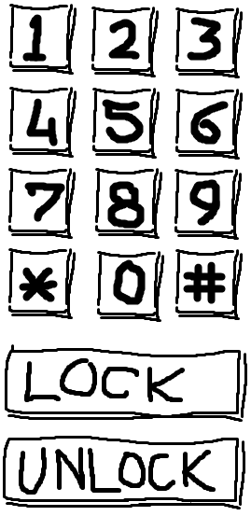
Example: Safe Home Access
Redesigned door keypad: includes the “Unlock”&“Lock” buttons
Analysis:
When a user types in the key and the system reports an invalid key, the user may not know whether the problem is in his fingers or in his memory: “did I mistype the correct key, or I forgot the key?”
To help the user in such a situation, we may propose to include a numerical display that shows the digits as the user types.

Slide 41
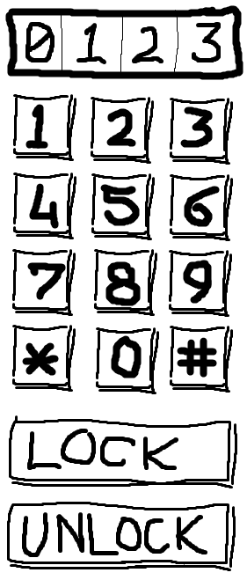
Example: Safe Home Access
Re-redesigned door keypad: includes the keycode display
Analysis:
There are several issues to consider about the display feature:
  How much this feature would increase the overall cost?
  Would the display make the door device bulky and inconvenient to install?
  Would it be significantly more sensitive to rain and other elements?
  Would the displayed information be helpful to an intruder trying to guess a valid key?

Slide 42
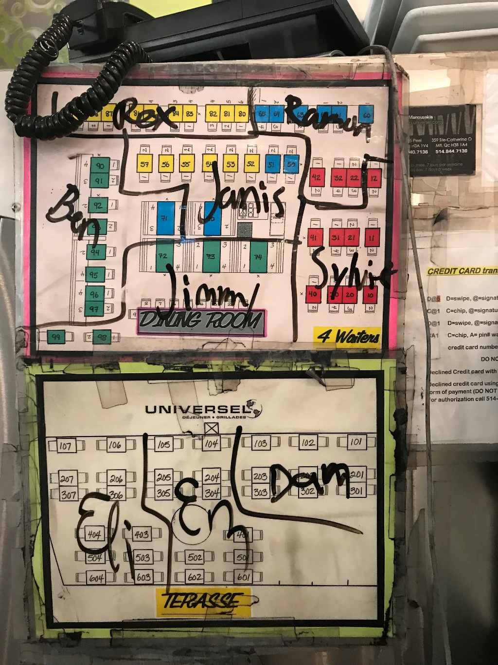
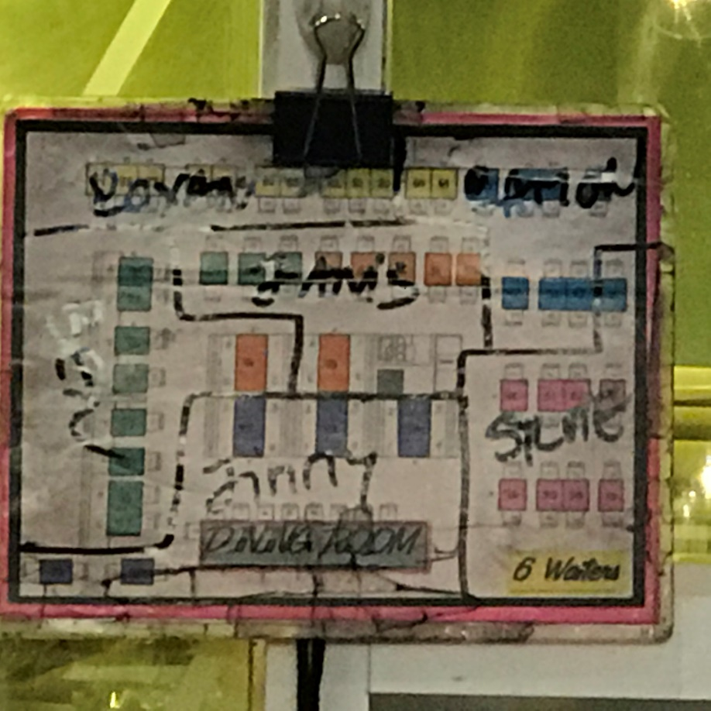
Restaurant Table Assignments

Slide 43
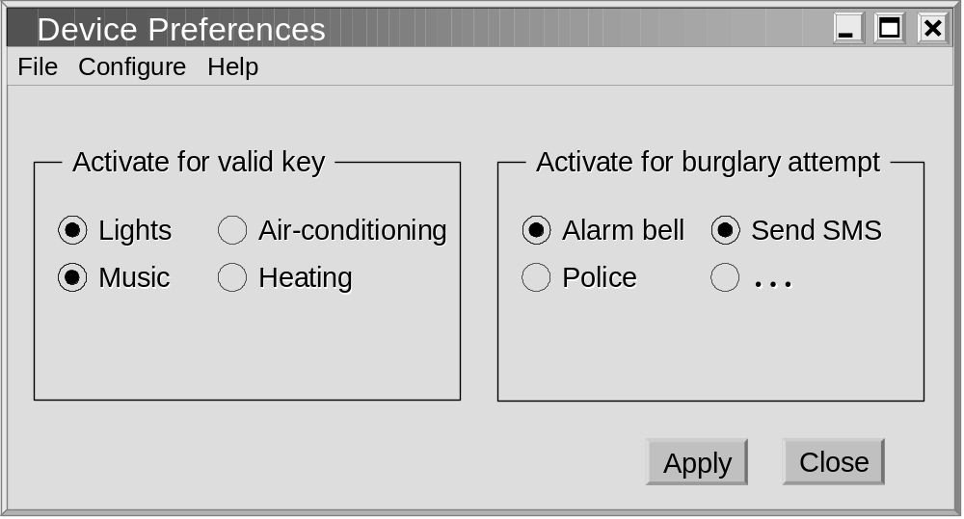
GUI for UC6: Set Device Pref’s
( NOTE: Lock device is mandatory, not an option )

